Slide 1


Redefining McGrath’s Value Proposition
AI and the Commoditization of Knowledge

Slide 2




Introducing the Team - C4
Introducing the team
Nistha Garg
Ankit Mishra
Yash Godbole
Dewaang Vig

Slide 3
The Atlas Pivot
EXECUTIVE SUMMARY
EXECUTIVE SUMMARY
Problem Identification
2
Strategy Recommendation
1
"Platform-Fortress" Hybrid Strategy with €280M investment.
AI is commoditizing the baseline generation of knowledge
3
New Consulting Framework
4
Implementation
From a labor pyramid to AI-powered strategic pods backed by centralized digital infrastructure.
New "Atlas" program includes B2B enterprise pre-sales
01

Slide 4
SITUATION & COMPLICATION
The Commoditization of Consulting
–9%
€170M
0%
Revenue Drop
Atlas Investment (Sunk)
Pricing Power Remaining
The Disruption
The Atlas Paradox
The Threat
Generative AI is shifting value from human-hours to governed data.
Clients' internal strategy units now demand AI-adjusted pricing at procurement.
The €170M Atlas investment created efficiency but broke the pricing narrative.
Faster analysis simply led clients to demand smaller fees for identical diagnostic output.
If McGrath fails to productize its governed data and methodologies, competitors or public models will be destroying the firm's remaining margin base permanently.
02

Slide 5
EVALUATING THE PATHS
The Inadequacy of the Status Quo
Path | Description | Growth Potential | Risk Level | Verdict
Efficiency Path (Keep Internal) | Atlas stays internal. Productivity gains absorbed by clients. | < 4% | Low | Slow death
Platform Path (Aggressive SaaS) | Full Atlas commercialization. €280M build-out. Subscription revenue model. | 9%+ | High | High reward, high risk
Fortress Path (Bespoke Advisory) | Retreat to complex, bespoke advisory. Protect IP, exit commoditized work. | Declining | Medium | Shrinking market
★ Hybrid | Platform-Fortress combination. Atlas funds the build. Partners elevated to strategic counsel. | Growing (investment de-risked) | Managed | ✓ Recommended
03

Slide 6
The Platform-Fortress Hybrid Strategy
THE CORE RECOMMENDATION
CORE RECOMMENDATION
THE PLATFORM
THE FORTRESS
Commercialized Atlas
Elevated Advisory
Proceed with Claire Dubois' €280M investment
Shift from selling diagnostic reports → subscription-based benchmarking copilots
Deeply embedded in client workflows (compliance, finance, operations)
Atlas’s Design Partners fund the build and generate training data
Partners exit day-to-day Associate management entirely
Focus purely on complex judgment calls and political navigation
Edge-case regulatory strategy that AI cannot execute
Priced at premium board-level advisory rates and not billable hours
04

Slide 7
REVENUE ARCHITECTURE
Client Billing Model Transformation
01
Subscription Revenue
TARGET REVENUE MIX
Sector benchmarking platforms
Regulatory copilots
Automated diagnostics
IN 5 YEARS
50%
Project
02
Outcome-Based Fees
30%
Subscription
KPI-linked transformation pricing
Shared upside models
15%
Outcome-Based
03
Strategic Advisory Premium
Board-level judgment
Regulatory crisis advisory
Complex restructurings
5%
Other
*These numbers are for illustration purposes only.
05

Slide 8
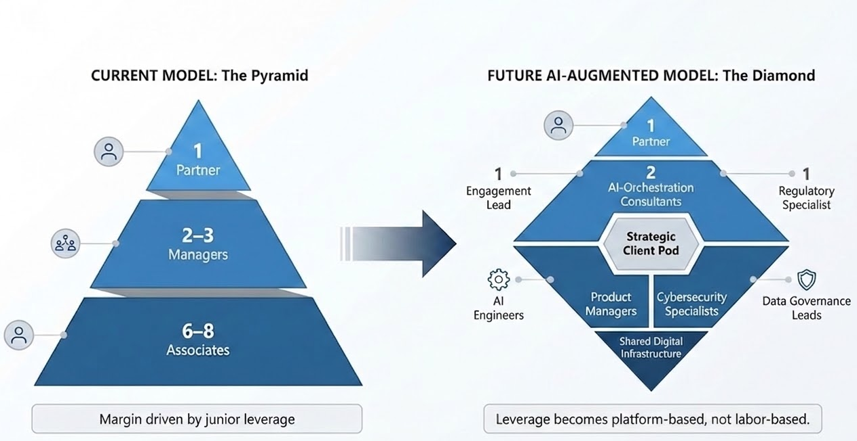
Consulting Team Redesign: From Pyramid to Diamond
Restructuring the Team
06

Slide 9
OPERATING MODEL & GOVERNANCE
Re-aligning Incentives for a Digital Era
01
02
03
Centralized IP & Product Management
New Partner KPIs
Elevated Digital Leadership
The Knowledge Office becomes a central Product Management division. Local practices only access Atlas's advance client-facing features by surrendering proprietary methodologies to the central engine.
Introduce "IP Contribution & Product Revenue" as a core Partner metric. Partners receive royalty-style bonuses for frameworks that scale into profitable SaaS modules.
CDO Claire Dubois must receive equal voting weight to Regional Managing Partners on the Global Executive Committee operationalizing digital strategy at the highest level.
07

Slide 10
RISK MANAGEMENT
Risk Mitigation & Regulatory Strategy
KEY EXPOSURES
MITIGATION MEASURES
!
Data Liability
✓
Dedicated AI Compliance Office
Client data used to train Atlas creates exposure if governance fails or breaches occur.
In-house team governing Atlas outputs, data handling, and regulatory alignment globally.
!
Cybersecurity Threats
✓
External Regulatory Audits
Platform attack surface vastly exceeds traditional advisory firm risk posture.
Annual third-party audits across key jurisdictions (EU AI Act, SEC, FCA) to pre-empt scrutiny.
!
Regulatory Scrutiny
✓
Expanded Cyber Insurance
AI-generated compliance outputs may face legal challenge across EU and US jurisdictions.
Platform-grade cyber coverage including SaaS-specific breach, outage, and liability policies.
!
SLA Contractual Penalties
✓
Structured SLA Liability Caps
Uptime and accuracy guarantees expose McGrath to financial penalties at scale.
Contractual ceilings on liability with tiered remedies, limiting downside from uptime or accuracy failures.
08

Slide 11
GO-TO-MARKET EXECUTION
Powering The "Atlas " Program
6–8 Tier-1 Design Partners · Multi-year ARR upfront · Training data access · Steering Committee seats
CLIENTS GIVE →
← McGRATH GIVES
Multi-year upfront ARR commitments that fund the €280M build
Permission to train Atlas on their complex, sanitized corporate data
Validated use-cases that prove product-market fit before broad launch
3-year heavily discounted licensing rates vs. future market price
Seat on the Atlas Steering Committee — direct roadmap influence
Priority access to new modules, benchmarks & compliance copilots
09

Slide 12
Roadmap for the Next 3 years
NEXT STEPS
PHASE- 1
0-12 MONTHS
PHASE - 2
12-24 MONTHS
PHASE - 3
24-36 MONTHS
Foundation
Build
Scale
Owner: Elena Kovacs
Owner: Partners + Legal
Owner: CDO + Partners
Announce clear leadership commitment to the Atlas strategy
Update compensation and KPIs to reward digital and product growth
Introduce a required Atlas knowledge-sharing policy
Finalize shortlist of Atlas’s launch clients
Launch benchmarking platform
ATLAS’s Design partner rollout
Embed Co-pilot in top 10 clients
Achieve 15% digital revenue
Diamond Org. Transformation
Partners Exit day to day management
Full platform market launch
Outcome based contracts at scale
Partner elevation to board advisory
50/30/15 Revenue Mix target review
Year 4 planning and recalibration
Evaluate geographic Atlas Expansion
10

